Slide 1
Customize this slide for your business!
[Insert Brand Name] + Snapchat

Slide 2
What is Snapchat
Snapchat lets users live in the moment by allowing them to easily talk with friends, view Live Stories from around the world, and explore news in Discover. Snaps live on the app for 24 hours, making it a unique opportunity for experimentation in both ad style and community engagement.

Slide 3
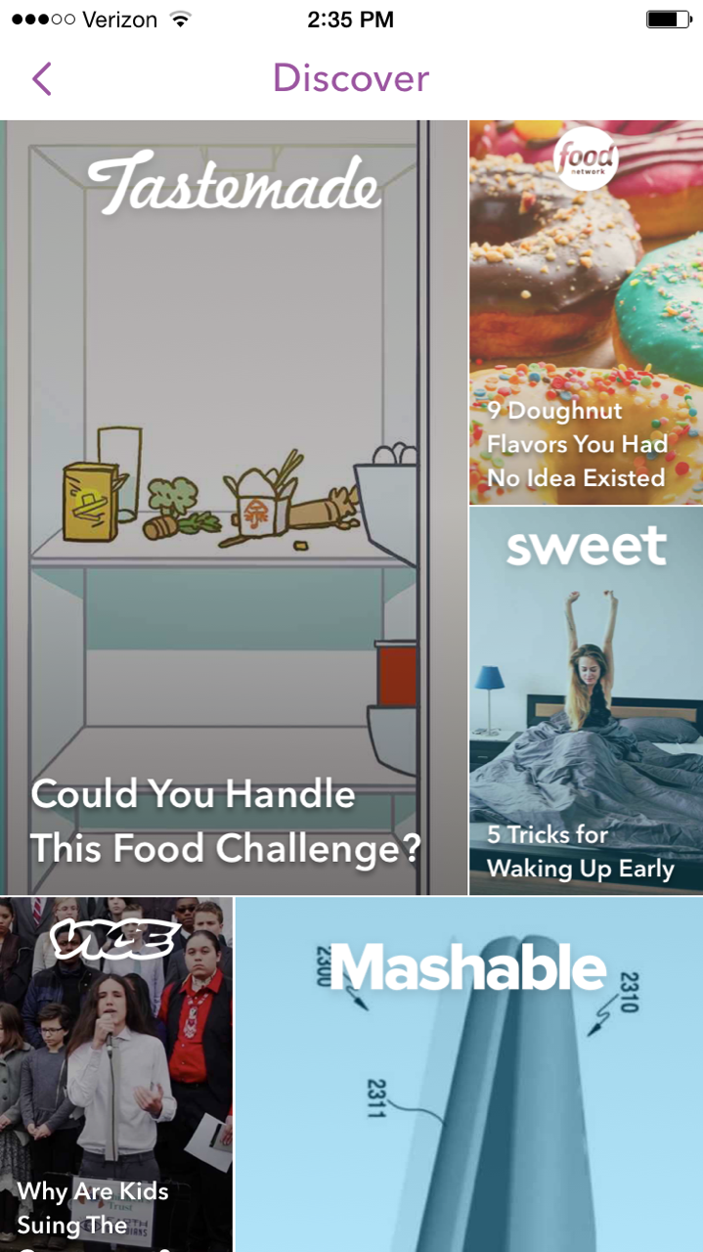
Snapchat Stats
• Daily Active Users: 150+ million
• Average Time Spent on Snapchat: 20-30 min.
• Snaps sent per day: 400 million
• Snaps sent per second: 9,000
• Snapchat Videos Watched Per Day: 10 billion
Statistics collected from: http://snapchat.com/ads

Slide 4
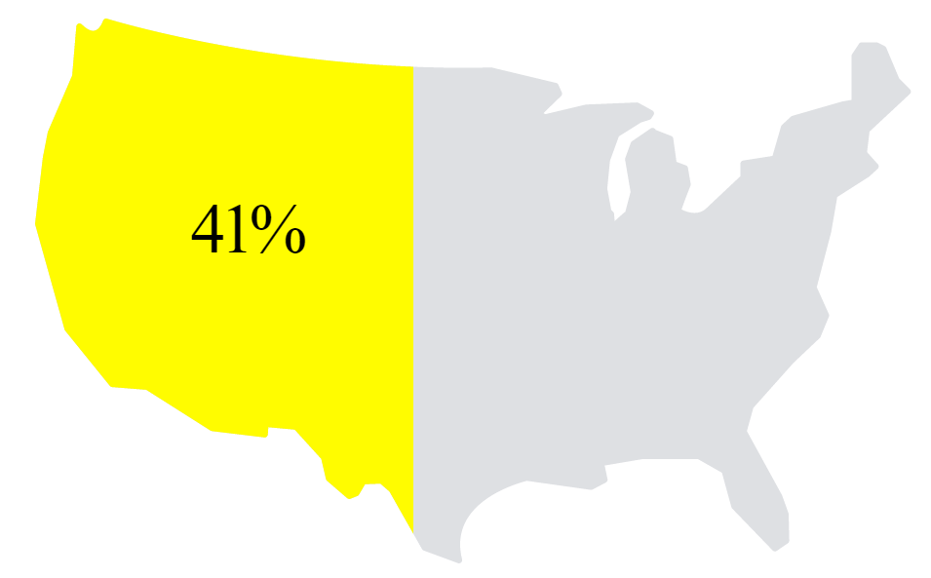
Snapchat Reach
• Reaches ~41% of 18-34 year-olds in the U.S.
• 86% of users are between 13-37 years old
• 54% of Snapchat users Snap every day
41%
Statistics collected from: http://snapchat.com/ads

Slide 5
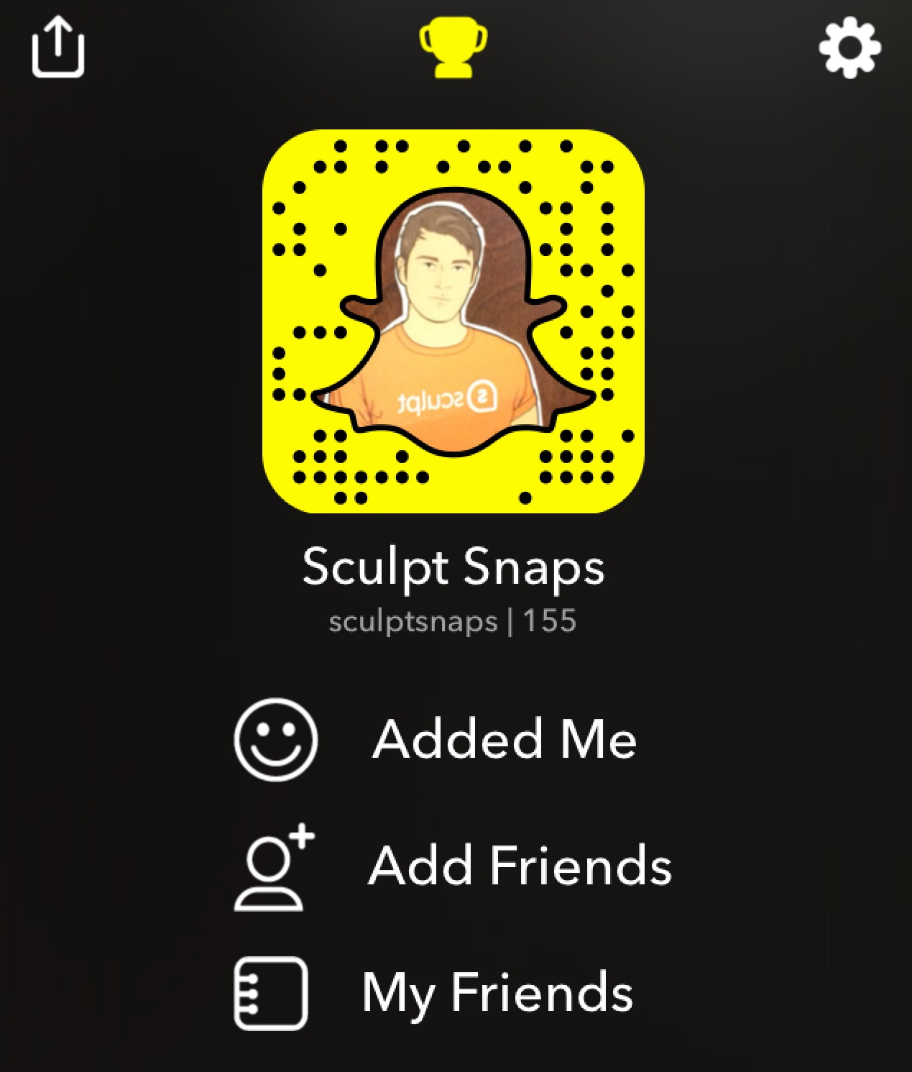
How it Works
• Set up an account (It’s free!)
• Post Snapcode on our social media accounts to encourage
current fans to follow us
• Send Snaps directly to individual followers
• Post Snaps on our story for our followers to discover
• Create a customized Geofilter for locations and live events

Slide 6
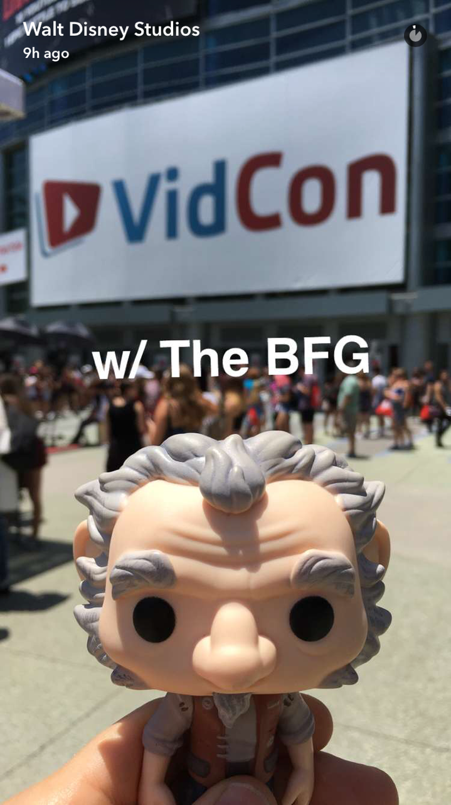
Snapchat Benefits
• Two-way conversation with our brand and users
• Encourages users to engage/create content with our brand
• The entire screen of a mobile phone is our creative canvas
• Builds trust with our consumers through authentic
representation of our brand and story

Slide 7
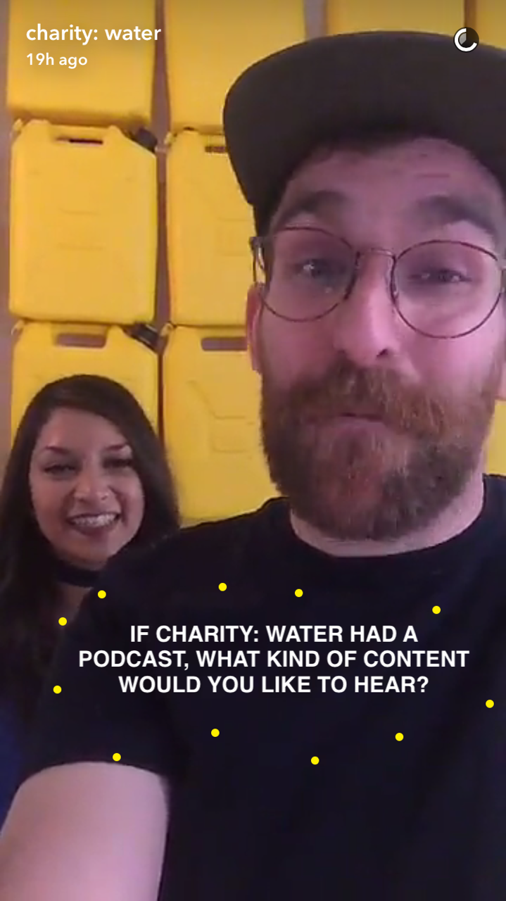
Who’s Doing it Well
Charity Water
• Excels at audience engagement — building an authentic
voice behind the brand
• Encourages followers to screenshot their input on blogging
and podcast decisions, so they can create content their
fans care about and are interested in
• Throws in subtle calls to action (ways to donate) after
giving a lot of audience-driven content. Never feels like the
CTA is the main reason for them to be on Snapchat.

Slide 8
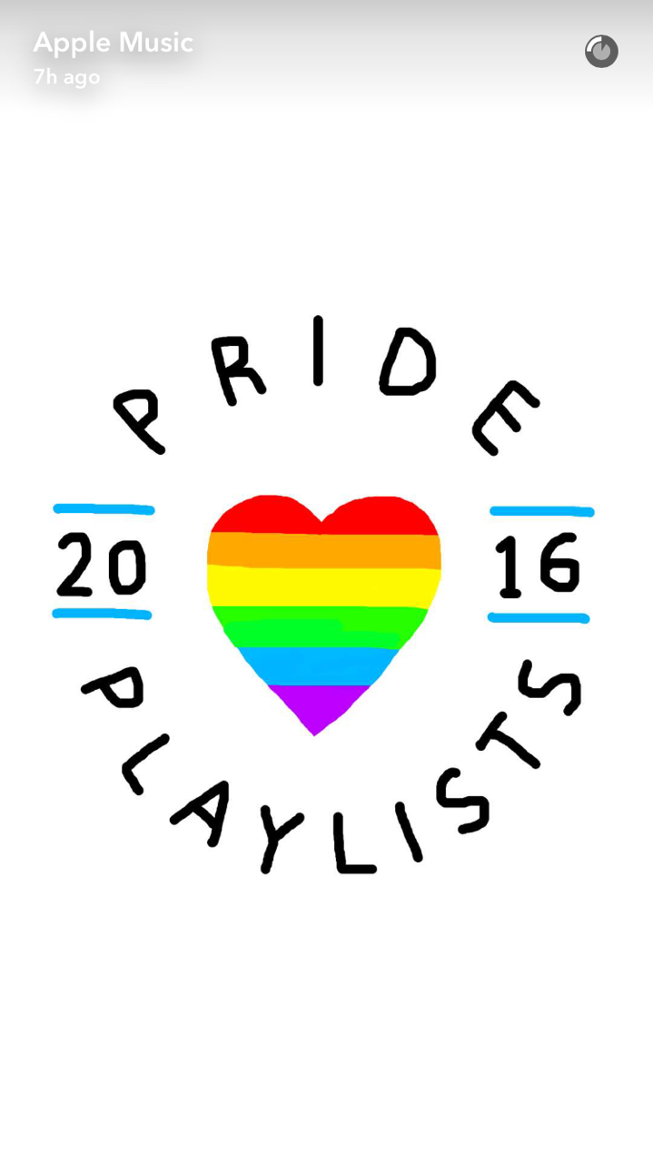
Who’s Doing it Well
Apple Music
• Releases elaborately drawn and visually pleasing stories
• Apple uses many layers to engage with their followers
(drawings, emojis, text, video, music)
• Prompts users to explore further on their website

Slide 9
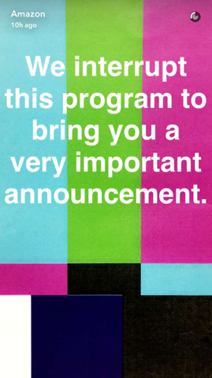
Who’s Doing it Well
Amazon
• Provides exclusive rewards to followers, coupons that
drive consumers to website and prompt sales
• Builds excitement through giveaways
• Incorporates promotional content between giveaway posts

Slide 10
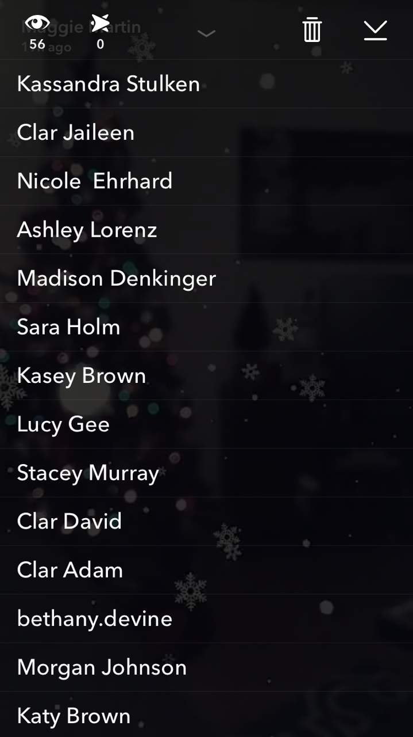
Measuring Success
• There are no true measurement tools within Snapchat yet.
Third party apps like Snaplytics* are on the cusp of creating
more in-depth tracking.
• In the meantime, we can count our engagements by the
number of people who:
- View our story
- Open our snaps
- Screenshot our snaps
- Complete our intended call-to-action
* http://marketingland.com/snaplytics-launches-snapchat-analytics-196692

Slide 11
Relative Cost & ROI
• Low production cost; it’s free to post, and only costs time it
takes for employees to create snaps and post them
• Geofilters start at $5 — the price becomes greater as your
*geofence and timeline expand
• Large-scale Snapchat ads average around $50,000+ for
national Geofilters or Lenses
*A geofence around the area of our office (43,251 Sq Ft) is $5 for 1 hour. For the 2 blocks around our office (304,167 Sq Ft) it costs $11.41 per hour. Cut down on costs for geofilters by only using them during business hours, or specific hours in the day when you have the most traffic.

Slide 12
The Competitor
Instagram Stories
• Still an emerging feature, Snapchat is still top-of-mind for
real-time video and photo sharing
• While Instagram has more users, the daily active user ratio
of Snapchat users is much higher
• These users spend 25 to 30 minutes on Snapchat.
Instagram users spend an average of 21 minutes on the app
per day. There are not metrics for time spent on stories.
*Statistics collected from: http://www.businessinsider.com/people-are-sharing-less-on-instagram-2016-6

Slide 13
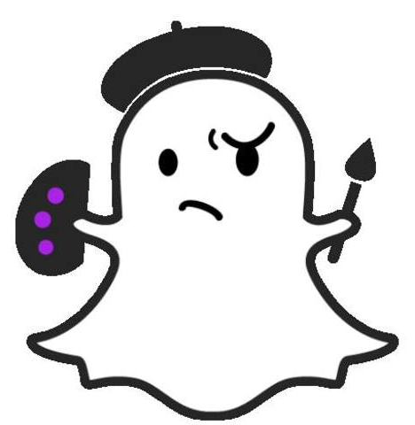
Should We Snap
Why is it a fit for our business?
Ex. Answer: Our brand is fresh, funky, and fun; so we should be on an emerging platform, like Snapchat!
How can we benefit?
Ex. Answer: There are several: it’s easy-to-use; it won’t break the bank; we can tell the world about our promotions, showcase our culture, and we can have authentic one-to-one conversations with our followers.
What important audiences can we reach?
Ex. Answer: We can reach the younger, social-savvy audience that we’re missing on other channels such as Facebook.
Customize this slide for your business!

Slide 14
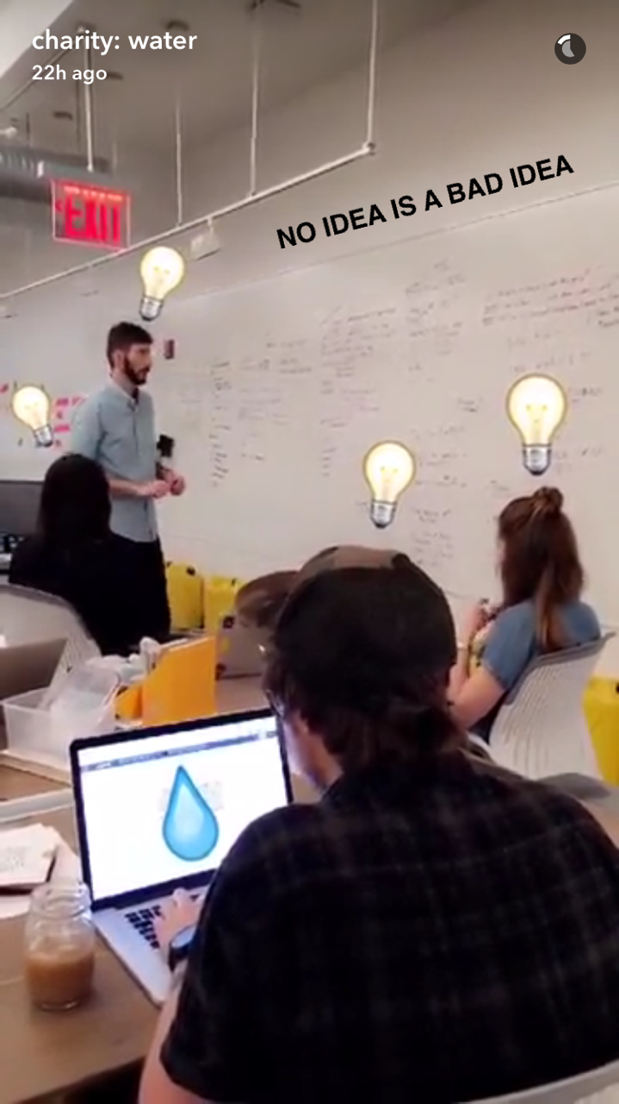
Let’s Get Snapping
What kind of Snaps can our business produce?
Ex. Answer: The options are endless! Through images, stories, video, and let’s not forget emojis, we could promote our products, showcase our company’s down-to-earth culture, post in real-time about our events, create a dialogue with our customers by asking them questions, and more!
What can we promote on Snapchat?
Ex. Answer: We can promote our sales, our culture, our events, and continue promoting our unique brand!
Customize this slide for your business!

Slide 15
Snapshot of Takeaways
• Supports our business strategy
• Relevant & emerging communication channel
• Not a huge investment in cost
• We can still be early to the game
• Easy to use

